Slide 1
IT Ticket Analysis
Sharath kumar R
Date -12 -10 -2024

Slide 2
About Project
This project analyzes IT support ticket data to evaluate agent performance, ticket resolution times, and employee satisfaction.
Key metrics like handling time, ticket volume, and satisfaction scores are used to identify improvements in staffing, training, and system upgrades, ultimately guiding decisions to enhance overall IT service quality.
The goal is to create a comprehensive dashboard that guides investment decisions to enhance overall IT service quality.

Slide 3
Data Summary
The dataset contains two primary tables:
Ticket:
Includes attributes like Ticket ID, Date (Fecha), Employee ID, Agent ID, Request Category, Issue Type, Severity, Priority, Resolution Time (Days), and Satisfaction Rate. This data tracks IT support requests, their urgency, and how quickly and satisfactorily they were resolved.
IT Agent:
Contains agent-specific information such as Agent ID, Full Name, Email, Year of Birth, Month of Birth, and Day of Birth. This data is linked to the ticket data for analyzing agent performance.

Slide 4
Ticket Volume By Category
Insights:
The "System" category accounts for the highest ticket volume (~39,002), followed by "Login Access" (~29,919).
"Hardware" issues are the least frequent, contributing only ~9,733 tickets.
Higher volumes in "System" and "Login Access" categories suggest critical areas to focus on for resource allocation.
Monitoring trends in these categories can help prioritize improvement initiatives.

Slide 5
Age vs Average Satisfaction Rate and Resolution Time
Insights:
Average satisfaction rates remain consistent across age groups, ranging between 4.1 and 4.3.
Average resolution time shows no significant variation with agent age, implying age-neutral ticket handling efficiency.
Peaks observed in specific age groups require further exploration for potential outliers .
Focus should shift from age-based analysis to operational and training aspects.

Slide 6
Distribution of Agent Based on Resolution Time
Insights:
The majority of agents resolve tickets within the 20,000 to 30,000 range.
A notable portion resolves tickets between 40,000 to 50,000, indicating varying efficiency levels.
Agents with lower resolution counts could indicate either specialized tasks or underperformance.
Further drill-down into individual agent performance is recommended.

Slide 7
Distribution of Agent Based on Satisfaction Score
Insights:
Most agents have satisfaction scores in the mid-range (scores 3 and 4), with ~5,077 agents scoring "3.“
High satisfaction scores (score 5) are achieved by ~2,752 agents, indicating excellence in service delivery.
A smaller number of agents with low scores (1 and 2) suggest targeted training opportunities.
Strategies to replicate high-satisfaction practices across all agents can boost overall satisfaction.

Slide 8
Ticket volume by Issue
Insights:
"IT Requests" dominate ticket volume (~71,222), significantly outweighing "IT Errors" (~24,276).
The disparity suggests a larger focus on preventive measures for requests.
Understanding root causes of requests could streamline processes and reduce volume.
Enhancing error resolution processes can minimize reoccurrence.

Slide 9
Yearly Ticket Volume
Insights:
Ticket volumes have steadily increased from 2016 (~13,051) to 2020 (~29,088).
Quarterly analysis reveals consistent growth, with notable peaks in Q3 and Q4.
The upward trend highlights increasing IT service demand and workload.
Resource planning and scalability measures are crucial to meet future demands.

Slide 10
Ticket Volume by Severity
Insights:
"Normal" severity tickets dominate (~86,556), while "Urgent" and "Major" tickets are minimal.
High volume in "Normal" category suggests standardized resolution processes.
Focus on minimizing tickets in "Urgent" and "Major" categories through proactive measures.
Severity categorization aids in prioritizing critical issues.

Slide 11
Ticket Volume by Priority
Insights:
"Unassigned" priority tickets form a significant portion (~29,410), indicating potential workflow gaps.
"Medium" priority tickets (~15,845) outweigh "Low" priority tickets (~16,684).
Streamlining priority assignment processes can improve efficiency.
Regular review of unassigned tickets is recommended to prevent delays.

Slide 12
Category-Wise Average Resolution Time
Insights:
"Hardware" issues have the highest resolution time (~7.43 days), requiring focused attention.
"System" category resolution time is comparatively lower (~4.62 days).
High-resolution times in "Hardware" and "Software" categories may impact satisfaction.
Optimizing processes for high-resolution categories can enhance overall efficiency.

Slide 13
Correlation Between Severity and Average Resolution time
Insights:
"High" severity tickets take the longest to resolve (~6.46 days), followed by "Major" severity (~3.91 days).
"Urgent" tickets surprisingly show lower resolution times (~2.18 days), likely due to prioritization.
The correlation indicates effective handling of urgent tickets but room for improvement in high-severity cases.
Implementing tiered escalation frameworks can improve resolution times for severe tickets.

Slide 14
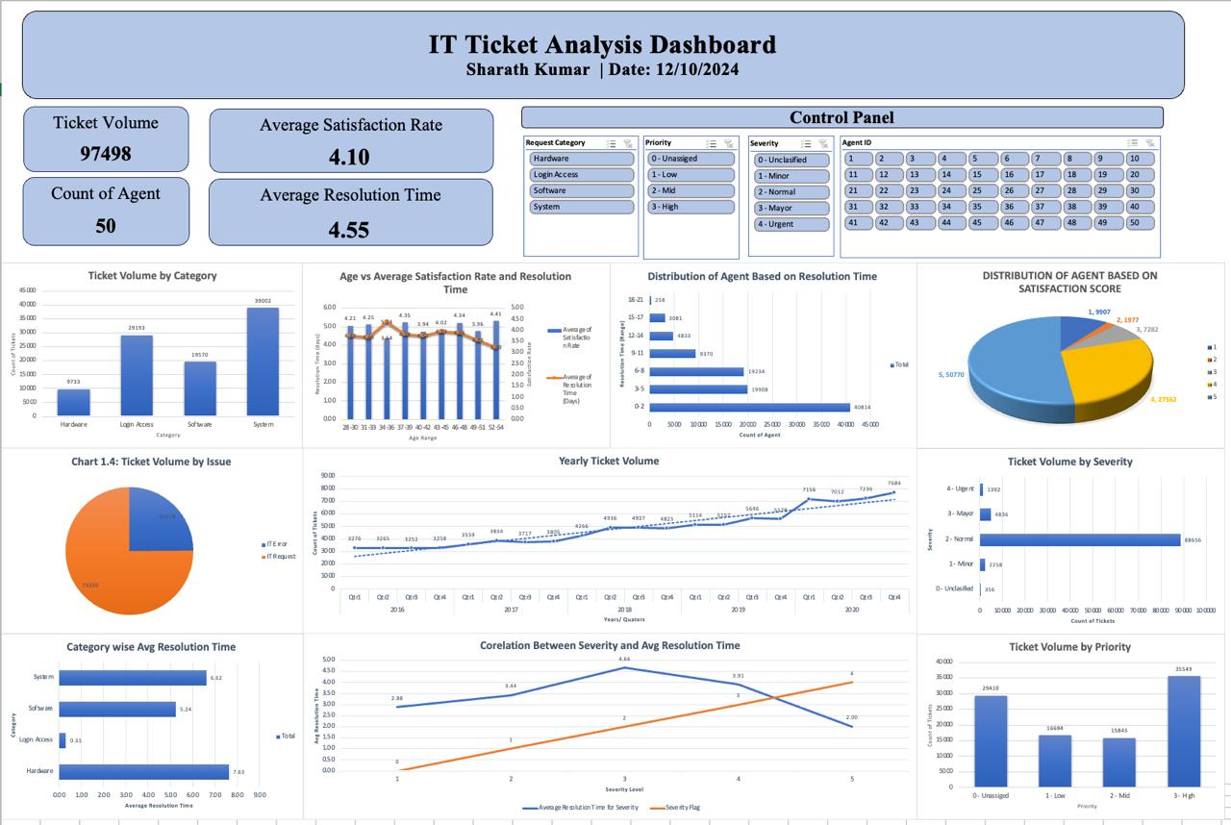
Dash Board Overview

Slide 15
Key Points:
This dashboard provides a comprehensive analysis of IT ticket data over multiple dimensions.
It includes key metrics such as ticket volume, average satisfaction rate, resolution time, and agent count.
Filters are available for request category, priority, severity, and agent ID to enable dynamic exploration.
The analysis is visualized across multiple charts for actionable insights.

Slide 16
Recommendations and Conclusion
Key Recommendations:
Focus on reducing resolution times for categories like "Hardware" and high-severity tickets.
Enhance satisfaction scores by replicating best practices of high-performing agents.
Address gaps in priority assignment to minimize unassigned tickets.
Allocate resources dynamically based on high-ticket volume areas (e.g., "System" category).
Leverage filters and dynamic dashboards for real-time decision-making.

